Slide 1
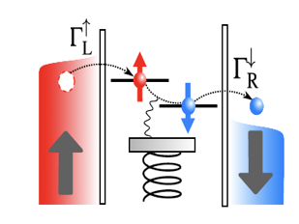
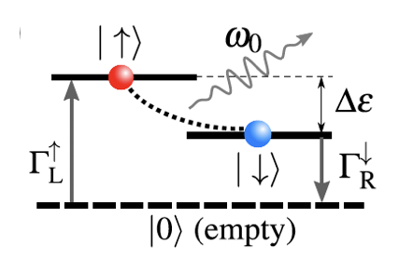
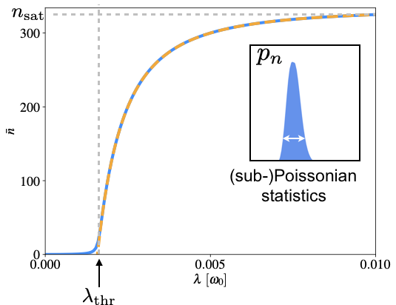
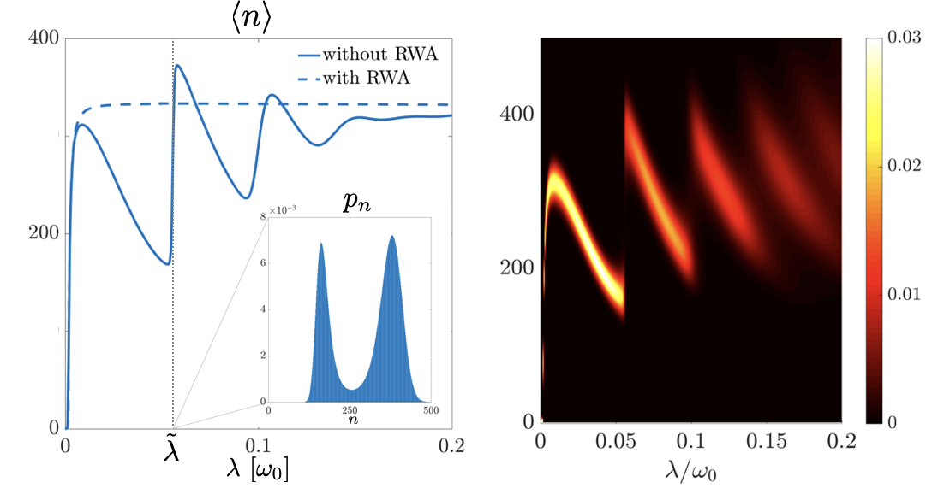
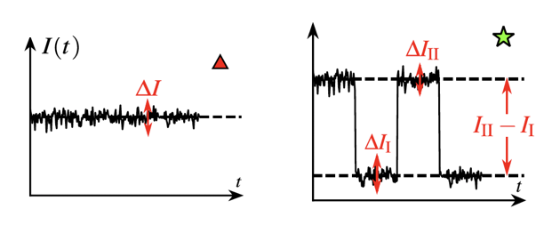

C03 Single-atom laser and single-photon pump
in quantum-dot-based hybrid nanodevices
M. Mantovani¹, A. D. Armour², R. Hussein¹, W. Belzig¹, and G. Rastelli^{1,3}
¹Fachbereich Physik and ³Zukunftskolleg, Universität Konstanz, D-78457 Konstanz, Germany
²School of Physics and Astronomy, University of Nottingham, NG7 2RD Nottingham, UK
Motivation and goals
Main results:
Multistability in a solid-state implementation of a single-atom laser and breakdown of rotating-wave approximation (RWA) without ultrastrong coupling [3]
Simultaneous ground-state cooling and photon transfer between cavities using a Cooper-pair splitter (CPS) [4]
Hybrid mesoscopic devices: quantum dots (QDs) coupled to electromagnetic or mechanical resonators are a platform to tailor interactions between subsystems. They allow to explore new regimes of photon-electron and phonon-electron interaction and new mechanisms of heat exchange [1,2]
Mesoscopic transport (single-electron and Cooper-pair tunneling) can be exploited to drive harmonic resonators into designed nonequilibrium states
I. Spin-valve quantum-dot laser:
breaking the RWA at weak coupling
II. Pumping photons between cavities
with a Cooper-pair splitter
System
QD embedded between ferromagnetic leads carrying spin-polarized current
Electron tunneling mediated by
spin-resonator coupling to single resonator mode, with strength λ
System
Central superconductor proximizing two QDs [7]
QDs tunnel-coupled to negatively-biased normal leads
Each QD capacitively coupled to local resonator
Strong Coulomb interaction U in the dot: effective coherent dynamics given by Rabi model
High bias voltage
Three-level structure
Coherent coupling between singlet and empty states: Andreev bound states
Q: quality factor of resonator
polarization
Methods
Master equation for system density matrix
Methods
Transition rates between eigenstates calculated through Fermi’s Golden Rule
Master equation for eigenstates populations [8]
Numerical solution for the steady state
(semiclassical approximation)
Nonlinear system of equations
Equivalence to three-level single-atom laser [5]
Numerical solution for steady populations
Results: breakdown of RWA and multistability
Results: nonlocal photon transfer between cavities
Jaynes-Cummings model:
Energy splitting of Andreev states:
Validity of RWA:
saturation
weak charge hybridization
strong asymmetry in transition rates
threshold coupling
numerical
Resonance:
semiclassical
[6]
nonlocal coupling
RWA breakdown without ultrastrong coupling:
achievable for
Current and photon occupation
Photon transfer mechanism
n
heated
cooled
Stability diagram of resonator (# of stable amplitudes)
Detection of multistability through current measurement
Efficiency of photon transfer
Energy quanta
transferred per unit time:
Rate of Cooper-pair injection:
Photons transferred per CP:
Near-unity transfer efficiency
References
[1] X. Mi et al., Nature 555, 599 (2018).
[2] J.J. Viennot et al., Science 349, 408 (2015).
[3] M. Mantovani et al., PRB 99, 045442 (2019).
[4] M. Mantovani et al., PRR 1, 0330xx (2019).
[5] Y. Mu and M. Savage, PRA 46, 5944 (1992).
[6] H. Carmichael and L. Orozco, Nature 425, 246 (2003).
[7] R. Hussein et al., PRB 94, 235134 (2012).
[8] M. Governale et al., PRB 77, 134513 (2008).

